Slide 1

Testing Statistical Hypothesis
Chapter 7 Part 3
Dr. Abolfazl Saghafi
Assistant Professor of Statistics & Data Science
Data Science Program Director
Notes:
Testing for mu on population type III

Slide 2
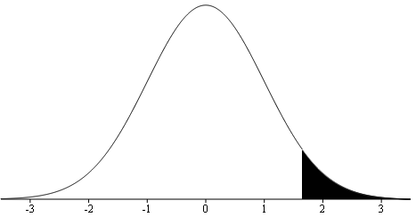


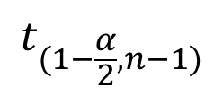
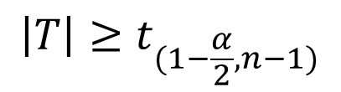
Testing population Mean (μ)
α% testing of μ
unknown
III
1. Find out the significance level α, use α = 0.05 if not given
2. Write down the null (H₀: μ = μ₀) and alternate (either
H₁: μ ≠ μ₀, H₁: μ > μ₀, or H₁: μ < μ₀) hypothesis
t Distribution
with (n-1) df
3. The test statistics is $T=\frac{\overline{X}−μ_{0}}{S/\sqrt{n}}$ compute its value
4. Determine the rejection region considering the alternate
Critical Value:
= InvT(1-α/2, n-1)
$$t_{(1−\frac{α}{2},n−1)}$$
$$\left|T\right|≥t_{(1−\frac{α}{2},n−1)}$$
$$T≥t_{(1−α,n−1)}$$
$$T≤{−t}_{(1−α,n−1)}$$
5. Reject H₀ if the computed value of $T$ is in the rejection region, fail to reject otherwise
6. Making an inference statement relating the decision to the problem
Notes:
So far we discussed testing pop mean in population type I and II. Here we have it for population type III, where the distribution is normal and population variance is unknown. The six-step is almost the same as previous procedure. The test statistics in here is a T and we have t-student based rejection regions.
Step 1: Specify (given) the significance level, α, commonly used values are α = 0.10, 0.05, 0.01
Step 2: State the null hypothesis and the alternate hypothesis so as to reflect the question’s claim.
Step 3: Write down the test statistic, compute its value given the provided information.
Step 4: Determine the RR based on the type of the alternate, use t-student distribution for RR
Step 5: Make a decision to accept or reject the null hypothesis based on the value from step 3 and RR.
Step 6: State the decision with regard to the problem.
$\left|T\right|≥t_{(1−\frac{α}{2},n−1)}$ means ($T≤−t_{(1−α/2,n−1)}$ or $T≥t_{(1−α/2,n−1)}$)

Slide 3





Ex1. Pyramid Lake
The Pyramid Lake in Nevada is famous for its cutthroat trout. Suppose the claim is that the mean length of the trout is 19 inches.
However, in a random sample of 51 fish caught, the average length was 18.5 inches with a sample standard deviation of 3.2 inches. Does this data indicate that the mean length of trout caught is less than the 19 inches claimed at the 5% level of significance? Assume normality for the population of length.
X: length of fish ~ Normal (μ, σ = ?)
III
$$n=51$$
$$\overline{x}=18.5$$
$$s=3.2$$
Claim: the mean length is 19 in
$$μ_{0}=19$$
Alternative: The mean length is less than 19 in

Slide 4
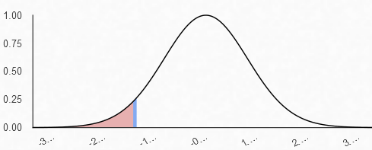

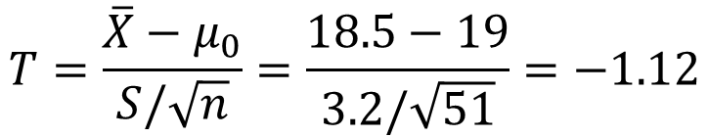
1. α = 0.05
2. versus
3. Test Statistic:
$$T=\frac{\overline{X}−μ_{0}}{S/\sqrt{n}}=\frac{18.5−19}{3.2/\sqrt{51}}=−1.12$$
4. Rejection Region:
$$T≤−t_{\left(0.95,50\right)}=−1.68$$
5. t = -1.12 is NOT in the rejection region, H₀ is NOT rejected
6. At 5% level of significance the mean fish length is still 19 in
7. P-value = $P\left(T≤−1.12\right)=tcdf\left(−99,−1.12,50\right)=0.1340$
Notes:
Using the p-value, since 0.1340 is NOT less than α = 0.05, we fail to reject H0, which is the same conclusion using the six-step process

Slide 5

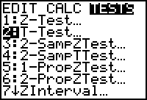
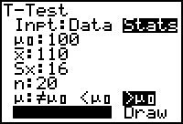
Using Calculator
Don’t be a Morty in using your calculator be at least a summer!
You can use the calculator to do pretty much the whole testing.
You should know your population type, the form of the alternate and some statistic to perform the testing.
Press STAT and the right arrow twice to select TESTS.
Select the highlighted 2:T-Test… Press ENTER.
Then either select Data (if you have entered your data into calculator) or Stats (if you have the statistics) and proceed.
Notes:
Practice using the calculator to check your final answer AND to score higher on the multiple-choice post-assessment test

Slide 6





Ex2. Camel Race
Some random guy who is trying to sell his camel claims that his camel runs on average 1km in 30 seconds!
To test his claim, they make the camel run a 1km distance 4 times and compute the average time as 35 seconds with sample standard deviation of 5.
Test the claim at 5% significance level. Assume normality of the average time.
X: Time to run 1km ~ N (μ, σ = ?)
III
$$n=4$$
$$\overline{x}=35$$
$$s=5$$
Claim: the mean time to run 1km is 30 seconds
$$μ_{0}=30$$
Alternative: The mean time is more
Notes:
We have a population type III since distribution is normal, the population standard deviation is unknown. If the camel could run the 1km distance in less than 30 seconds, that would be even more in favor of the claim. Therefore, the alternate is the time more than 30.

Slide 7
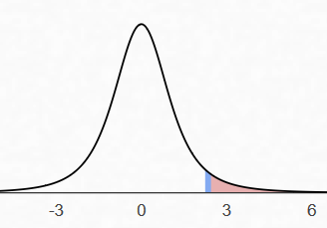

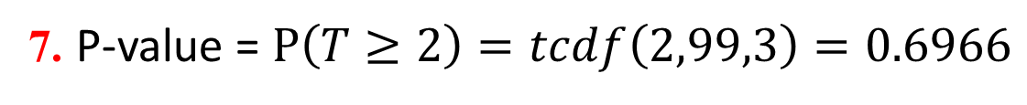
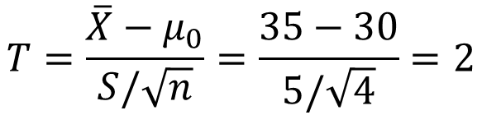
1. α = 0.05
2. versus
3. Test Statistic:
$$T=\frac{\overline{X}−μ_{0}}{S/\sqrt{n}}=\frac{35−30}{5/\sqrt{4}}=2$$
4. Rejection Region:
$$T≥t_{\left(0.95,3\right)}=2.35$$
5. t = 2 is NOT within the rejection region, so H0 is NOT rejected
6. At 5% significance level there is insufficient evidence to reject the null hypothesis and the camel runs a 1km distance in 30 seconds
7. P-value = $P\left(T≥2\right)=tcdf\left(2,99,3\right)=0.6966$
Notes:
Using the p-value, since 0.6966 is NOT less than α = 0.05, we fail to reject H0, which is the same conclusion using the six-step process

Slide 8





Ex3. Soda Bottles
A Soda Company produces soda in bottles labeled 32 oz. A random sample of 25 bottles yielded a sample average of 31.8 oz.
At the 10% significance level and given the sample standard deviation of 0.6 oz, test the claim that the mean volume of soda is 32 oz against a two-sided alternative. Assume normality.
X: Soda in each bottle ~ N (μ, σ = ?)
III
$$n=25$$
$$\overline{x}=31.8$$
$$s=0.6$$
Claim: the mean amount of soda in bottles is 32 oz
$$μ_{0}=32$$
Alternative: It is not 32 oz

Slide 9
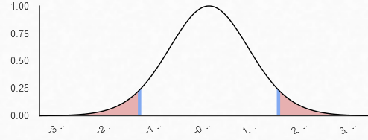
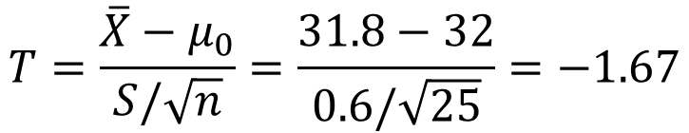

1. α = 0.10
2. versus
3. Test Statistic:
$$T=\frac{\overline{X}−μ_{0}}{S/\sqrt{n}}=\frac{31.8−32}{0.6/\sqrt{25}}=−1.67$$
4. Rejection Region:
$$|T|≥t_{\left(0.95,24\right)}=1.7109$$
5. t = -1.67 is NOT within the rejection region, so H₀ is NOT rejected
6. At the 10% level of significance, there is insufficient evidence to reject the null hypothesis and the average soda in bottles is 32 oz
7. P-value = $P\left(\left|T\right|≥1.67\right)=2∗tcdf\left(−99,−1.67,99,24\right)=0.1079$
Notes:
Using the p-value, since 0.1079 is NOT less than α = 0.10, we fail to reject H0, which is the same conclusion using the six-step process
$\left|T\right|≥t_{\left(1−\frac{α}{2},n−1\right)}=t_{\left(0.95,24\right)}=invT\left(0.95,24\right)=1.7109$ means $T≤−1.711$ Or $T≥1.711$

Slide 10

Practice Problems Part 3
1. A tire dealer claims his competitor's tires last less than 40,000 miles, on average. The competitor sues the dealer and the courts order the dealer to back up his claim with statistical evidence or pay a fine.
They instruct the dealer to purchase 36 of the competitor's tires and run them until they fail to pass the DMV test. The dealer follows the instructions and ends up estimating from the sample an average of 39,300 miles with a standard deviation of 2,500 miles. Does the data support the tire dealer claim? Decide with 1% significant level. Assume normality.
This testing process is usually required to achieve certain standards in many industries.
Notes:
Answers are in Ch7 Practice Problem Solutions

Slide 11

Practice Problems Part 3
2. An inventor has developed a new, energy-efficient lawn mower engine. He claims that the engine will run continuously for 5 hours (300 minutes) or more on a single gallon of regular gasoline.
Suppose a simple random sample of 30 engines is tested. The engines run for an average of 295 minutes, with a standard deviation of 20 minutes. Do we have enough evidence in the data to conclude that the engine runs continuously for less than 5 hours? Test at 10% significance level. Assume normality.
The run-time of vehicles after fully charged in an important factor which is measured the same way, then advertised.
Notes:
Answers are in Ch7 Practice Problem Solutions

Slide 12
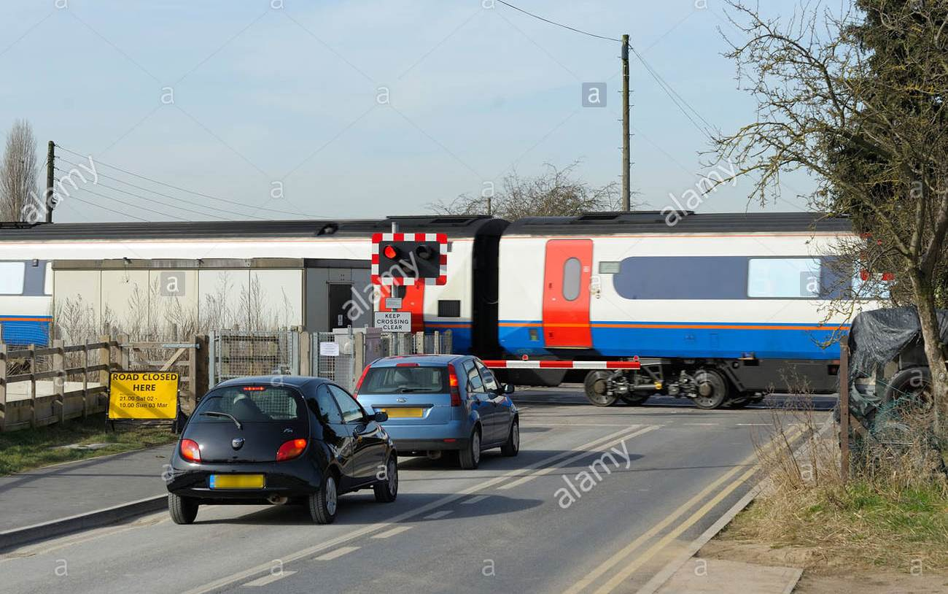
Practice Problems Part 3
3. A Canadian railway company claims that its trains block crossings no more than 7 minutes per train on the average. A consumer advocate group seeks evidence against the company's claim.
The actual times (minutes) that 10 randomly selected trains block crossings were recorded:
10.1 9.5 6.5 8.0 8.8
12 7.2 10.5 8.2 9.3
Assuming normality for the blocking times, do we have enough evidence against the company’s claim?
Notes:
Answers are in Ch7 Practice Problem Solutions

Slide 13

Practice Problems Part 3
4. Historical mean temperature of May in Tampa is 82ᵒF. In the past 5 years the average temperature of May in Tampa is registered to be 90ᵒF with standard deviation of 9.
Test the global warming claim with 5% level of significance. Assume Normality for the distribution of temperature in Tampa in May.
Global Warming is REAL
Notes:
Answer is not provided, you should be able to confidently figure it out after going over the past problems.

